Slide 1
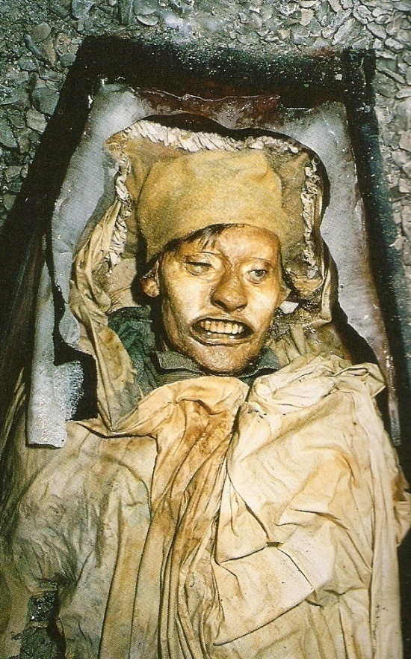
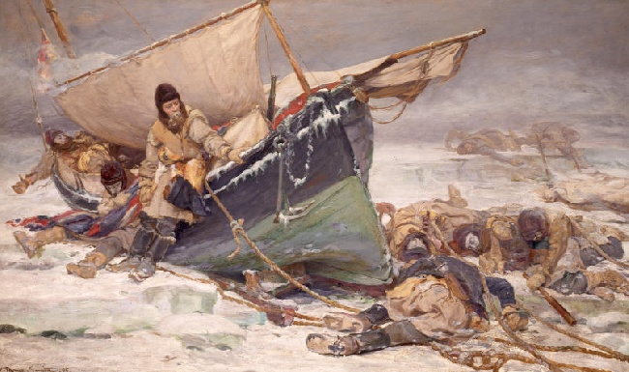
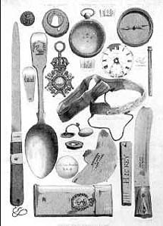
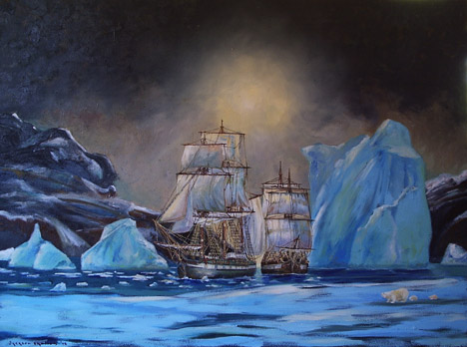
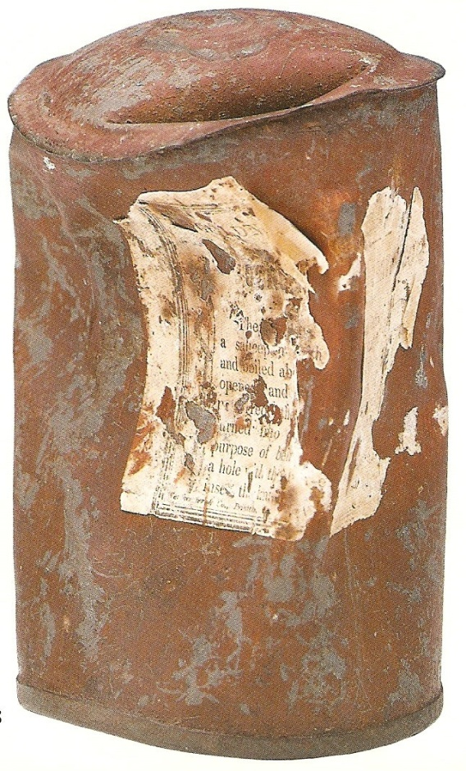
Background
In May of 1845, Sir John Franklin set off with his crew of 128 officers and men in the HMS Erebus and Terror. It was one of England’s largest expeditions ever sent out to find the Northwest Passage (Cookman xi). However, the expedition never returned. The ships were last seen on July 26, 1845 by the crews of the Prince of Wales and the Enterprise. Franklin’s crew was waiting to cross Baffin bay to Lancaster Sound.
There was no real concern for the fate of the expedition because they had left England with enough provisions to last five years, but in 1848, the British Admiralty sent out three expeditions to find and relieve the crew. When all three failed in their efforts, England finally realized something went horribly wrong. In 1850, the government offered a £20,000 reward to anyone who could help in the discovery of Franklin and his men, £10,000 to anyone who could relieve the crews, and £10,000 to anyone who uncovered the fate of the expedition (Frozen in Time, 19).
On August 27, 1850, three graves of Franklin’s men were discovered on Beechey Island: those of William Braine, John Hartnell, and John Torrington (Frozen in Time, 24). The headstones explained that most of the crew survived the winter of 1845-1846 on theIsland. Other signs of the crew were found on the island as well: remains of campsites, a storehouse, and other structures. The discovery of these three graves brought up even more questions: why did these men die so early and where was the rest of the crew?
In October of 1854, Dr. John Rae, who had been living like the Inuit, discovered natives with items from the Franklin Expedition (like forks, spoons, and one of Franklin’s medals). These natives inhabited an area much farther south than the main search areas. Rae discovered that other Inuit had seen forty white men headed southward. These men had put their lifeboats on sledges and pulled them across King William Island. The Inuit explained that these men died from starvation and heard that their boats were destroyed by ice (Buried in Ice, 48).
To discover the validity of Rae’s news, Lady Franklin hired Captain M’Clintock in 1857 to search King William Island. On the southern coast of the island, M’Clintock found a human skeleton in a steward’s uniform, and farther north, he uncovered a note explaining that the expedition’s second winter was spent on the northwest coast of the island. In fact, the Erebus and Terror had been stuck in the ice from September of 1846 through April of 1848, when the crew deserted the ships. Twenty-four crew members, including Sir John Franklin, had died. The rest of the crew decided to travel south to find the river. M’Clintock tried to follow the crew’s path south and discovered one of the lifeboats. It was carrying two skeletons along with heavy cookstoves, button polish, and other trivial objects (Buried in Ice, 50).
M’Clintock’s discoveries shed light on the last days of the Franklin Expedition, but they do not explain how the crew members died. These men were tough, armed, and well-supplied, yet possibly died of hunger and malnutrition (and evidently resorted to cannibalism) in an area where the Inuit had been able to survive for centuries without the same technology.
Currently, no one knows the exact cause of the doomed Franklin Expedition. Theories and possibilities include pneumonia, tuberculosis, starvation, and scurvy. Another argument is that the crew met their fate because they were heavily lead poisoned. There is a significant link between the crew’s supplies and behavior, and the lead content found in their bones and tissues, to support the accusation.
Lead as the Culprit
As part of the “1845–1848 Franklin Expedition Forensic Anthropology Project,” Dr. Owen Beattie excavated the grave sites of three crew members of the Franklin Expedition. He ran lab tests on tissue, hair, and bone samples collected from John Hartnell, William Braine, and John Torrington. The bodies had been perfectly preserved in the Arctic ice. In early 1987, lab results revealed excessively high lead content in the three men. The concentrations of lead were substantially greater (up to 30 times greater) than in modern populations or in people currently exposed to lead occupationally (A. Keenleyside). Torrington’s levels were 110-151 ppm, when the modern average is about 5-14 ppm (Frozen in Time, 123). The distribution of the lead in the bones indicates that the lead intake occurred during the expedition – not before the voyage. To make this conclusion, Beattie used tissue with a short half-life for lead. From the bone lead results, predictions for blood lead levels could be made. It appeared that the present limit recommended to prevent interference with neurological functioning was exceeded (A. Keenleyside).
In 1981, another skeleton was discovered – this time at Booth Point – and found to have even greater lead levels. This is probably due to the fact that this sailor outlived Torrington by two years, so he was exposed to lead from the expedition for a longer time.
Symptoms
When the very thin bodies of John Hartnell and John Torrington were uncovered, it was obvious that they had lost the ability or desire to eat long before their deaths. This loss of appetite accompanied weakness and other physical afflictions, such as colic, of the crew. Their levels of lead poisoning suggest that it may have affected their mind leading to unpredictable and illogical behavior. Some examples of this behavior include the irrational decision to carry iron stoves on sleds and resorting fairly early to cannibalism – food supplies were found on land (A. Keenleyside). There was also a high ratio of officer deaths. Nine of the twenty-one officers died prior to the expedition’s walk south (Frozen in Time, 162). The officers were considered a higher class, so they probably used pewter (made with lead) utensils and consumed larger portions of the expedition’s rations (tin cans contained lead solder).
John Hartnell
Beattie’s autopsies show that Hartnell, Braine, and Torrington also suffered from tuberculosis and their death was probably the result of pneumonia, but lead from the expedition most likely weakened and poisoned them in the first place. This then made them more susceptible to other diseases.
The test results would be much more accurate if the scientists had measured the lead levels in the teeth as well as in the bones. Lead levels in teeth reveal how much lead one is exposed to while growing up, as the teeth are forming. This would have given us a better idea of how much lead really did come from the expedition itself. Also, Beattie tested the levels of Inuit and caribou so he was able to conclude that the lead was not from the arctic (W. Kowal). However, he compared the crew’s levels to modern individuals, so the results are no as reliable since public lead levels fluctuate over time.
THE FATE OF THE FRANKLIN EXPEDITION
Kerry Conway
Lead Soldered Tin Cans
The Franklin Expedition was well-stocked when it set off to find the Northwest Passage. They were supplied with over 8,000 tin cans of food (Buried in Ice, 55). In the nineteenth century it was common practice to seal cans with solder – a mixture of about 90% lead and 10% tin. This technique was supposed to be beneficial as it allowed food to be preserved for extended periods of time. But in the case of Sir John Franklin and his men, it was probably fatal. The quality of the tin can fragments found on Beechey Island indicates a lapse in quality control, and possibly a significant amount of spoiled food for the crew. The ends of the seams were not fully sealed. Owen Beattie and his group of researchers calculated that each sailor was probably given a half pound of food from the tin cans every other day (Frozen in Time, 160). The solder of these particular cans appeared to have been sloppily applied and in excessive amounts. When filled, dangerous amounts of lead would have seeped into the food, thereby bringing harm to the sailors when they thought they were being nourished. Beattie tested the composition of lead isotopes in the bodies they found against the lead from the cans, and was able to identify the cans as the source of lead in the crewmembers (J. Geiger). The lead isotope ratios were analyzed by mass spectrometry methods (as lead from different sources has different “fingerprints”), which demonstrated that the lead from the sailors’ tissues was a match with the solder (W. Kowal).
In Conclusion
The effects of lead poisoning greatly contributed to the catastrophe of the Franklin Expedition (J. Marsh). There were many other contributors, including scurvy, pneumonia, cannibalism, and tuberculosis, but most of these more easily occurred or were exaggerated by the crew members’ exposure to lead. Keith Thomas Henry Farrer still contends that the intake of lead from canned foods was trivial and unlikely to have affected the health of the Franklin crews. He suggests that there were higher amounts of environmental lead during that time in Britain. However, until the ships and the rest of the Franklin Expedition are found, there is no definitive answer. Even then, there may be no way to know exactly what brought about the disaster. In the early 1990s, more skeletons of crewmembers were discovered. These skeletons also had traces of high levels of lead (A. Keenleyside). While discoveries are still being made, it is apparent that lead played a major role in the fate of the Franklin Expedition.
Relics of the Franklin Expedition
Other Sources – Water Distilling
While the source of lead from soldered tin cans was the most prevalent on the expedition, there were other sources as well. Tea was wrapped in lead foils, pewterware was used for meals, and there were lead-glazed pottery vessels on board as well (Frozen in Time, 160).
William Battersby argues that the tins of food were not the primary source for lead poisoning. He believes the water system designed for the ships was the cause. His research tries to explain why the Franklin Expedition ended in complete disaster even though other more-successful expeditions had been supplied with tin cans and had had crewmembers get scurvy as well. The Erebus and Terror were fitted with standard “Sylvester’s Patent Furnaces” and “Fraser Patent Furnaces,” which used coal to move heat through air ducts around the ship and distill seawater. Tanks were hung from the upper decks that could melt snow or ice using the heat of the galley. This equipment was changed specifically for the Franklin Expedition. The furnaces were fitted with different pipes and railroad engines.
Battersby claims that the pipes and taps used were made from lead with lead soldered joints. Water distilled by these pipes would have been in constant contact with the fresh lead. The amount absorbed was higher because the water was freshly distilled, the installed lead was new and had no layer of scale, and the water was warm to hot. The members of the Franklin Expedition would have ingested the lead through drinking water and even through bread prepared on board with just flour and lead-contaminated water. Battersby’s argument also explains why the death-rate among the officers was higher. They would have been giventhe freshly distilled water instead of stale water stored in the ships’ tanks, and would probably have been given more bread.
Tin can from Franklin Expedition

