Slide 1
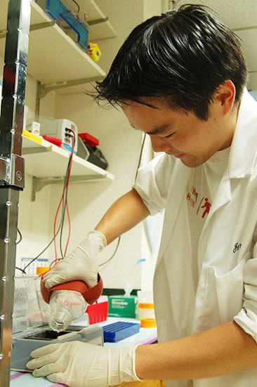
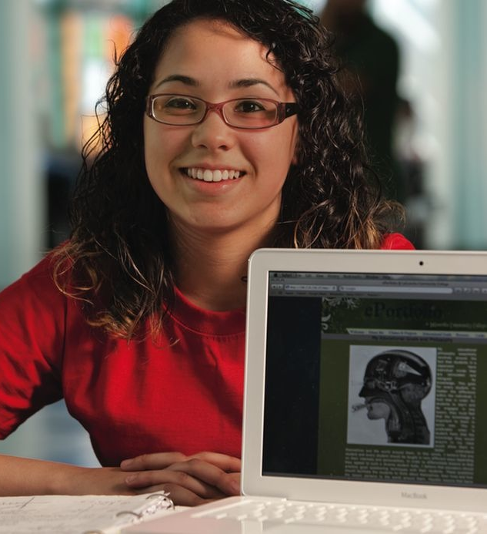
Catalyst for Learning: ePortfolio and the Future of Higher Education
Randy Bass
Georgetown University
Loyola University
October 24, 2014

Slide 2
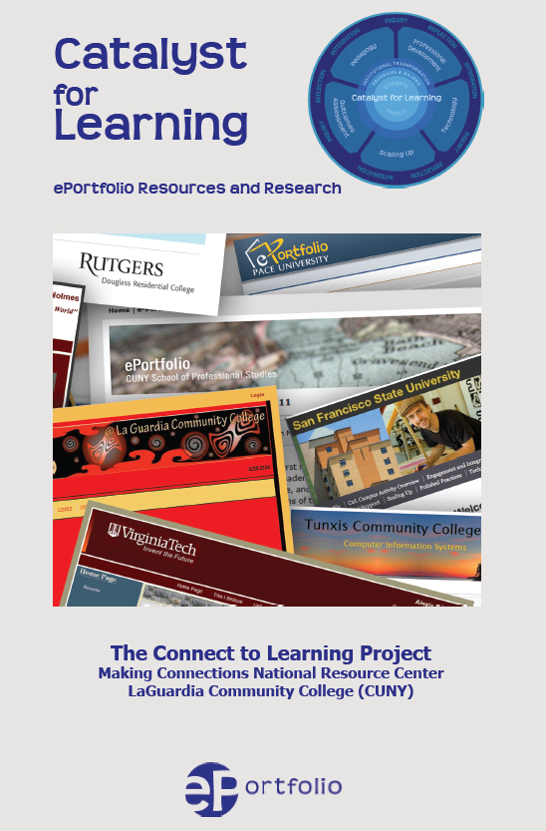
ePortfolio: What Have We Learned?
Findings from the
Connect to Learning Project
C2L.mcnrc.org

Slide 4
What Difference does ePortfolio Make? C2L evidence supports 3 preliminary claims
Sophisticated ePortfolio initiatives:
Advance Student Learning & Success
Make Student Learning Visible
Catalyze Institutional Change

Slide 5
ePortfiolio help institutions address priorities and meet challenges they didn’t know they had thirty years ago.
“ePortfolios are rare among innovations in that they are not really replacing anything.”
(Trent Batson)

Slide 6
What difference could Learning Portfolios make to the
future of higher education?

Slide 7
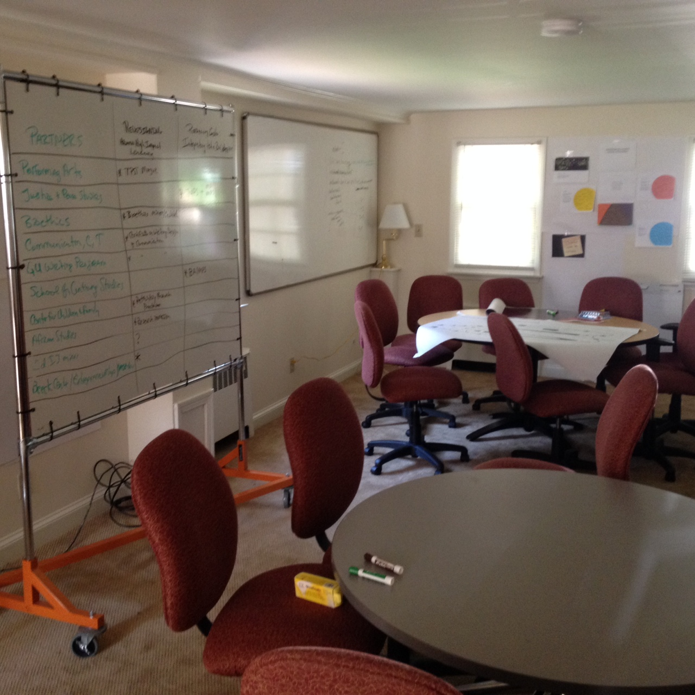
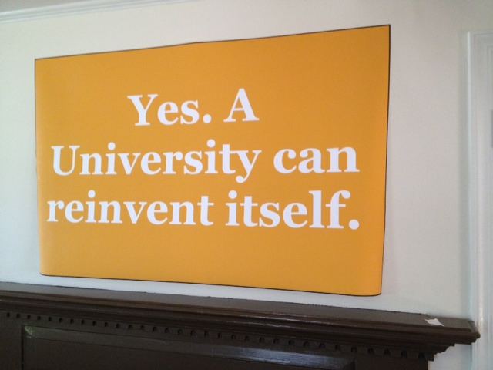

Slide 8
Three Assumptions
Designing the Future(s)
The university no longer has a monopoly on learning and certification.
In 5-10 years, we will be
out-competed on costs on information and content delivery.
In the new landscape, there are only two dimensions of education that will be unique to universities:
Mentored learning
The arc of learning

Slide 9
Creating a sustainable model
for a transformative education.
What’s it take?
CONNECT aspects of the university that have typically been disconnected.
UNBUNDLE some of our structures in order to give us more flexibility to innovate and integrate.
Find new ways to SHAPE a whole education that takes full advantage of the new learning ecosystem that is much larger than the university.

Slide 10
Being Disrupted and Disrupting Ourselves

Slide 11
Being Disrupted

Slide 12
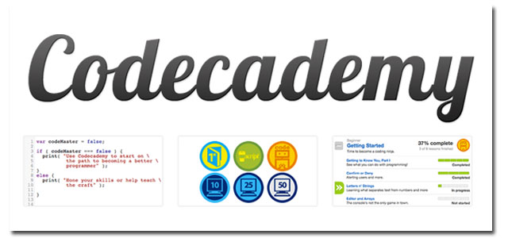
Skill-based Learning
Open Online Courses
External Forces of Potential Disruption
Data Analytics / Adaptive Learning
Public Pressure on Access, Metrics of Impact

Slide 13
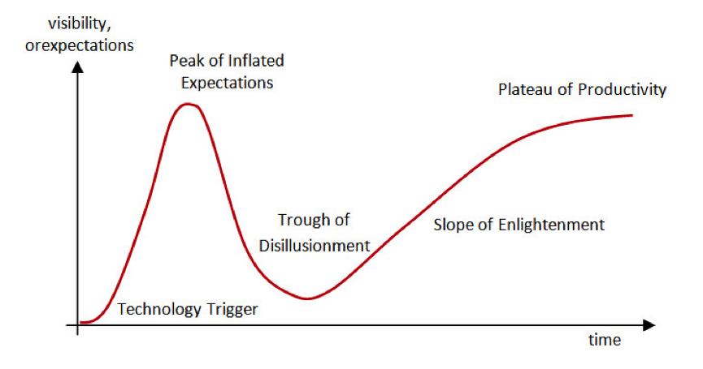
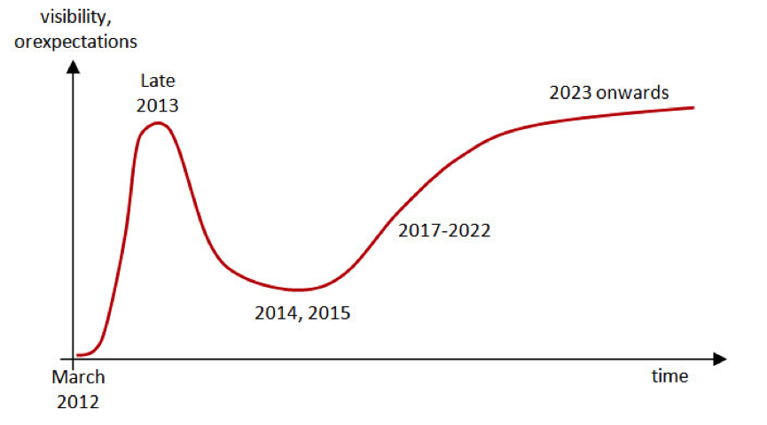
Gartner Group Hype Cycle
MOOC
Hype Cycle
http://pando.com/2013/09/13/moocs-and-the-gartner-hype-cycle-a-very-slow-tsunami/

Slide 14
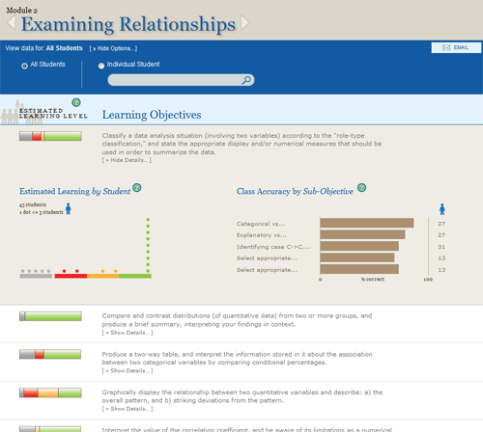
Learning Analytics
Adaptive Learning
Intelligent tutors

Slide 15
“I have 150,000 data points about your students that you don’t have.”
CEO, Knewton

Slide 16
We are working out a great tension between integration and dis-integration.

Slide 17
The split logic of the learning paradigm
Disintegrative (granular):
Design of discrete experiences
Outcomes driven
Competency-based
Focus on what’s measureable
Learning decoupled from formal boundaries
Integrative (holistic, coherent):
Design of whole learning experiences
Curricular and co-curricular
Competencies as part of a whole vision of learning
Connections
Formation

Slide 18
Disrupting Ourselves

Slide 19
Our understanding of learning has expanded at a rate that has far outpaced our conceptions of teaching.

Slide 20
Learning Paradigm:
Learning –focused
Outcome-driven
Student-centered
Expanding understanding of learning &
changing skillset required for the 21st C
Growing mismatch between these changing aspirations for learning and our structures

Slide 21
High Impact Practices (National Survey of Student Engagement--NSSE)
First-year seminars and experiences
Learning communities
(Common intellectual experiences)
Writing-intensive courses
Collaborative assignments
Undergraduate research
Global learning/ study abroad
Internships
Community-based learning
Capstone courses and projects
George Kuh, High Impact Practices: What are they, who has access to them, and why they matter. (AAC&U, 2008)
Notes:
This is the list of High Impact Practices, according to the data that has come out of NSSE. You’ll note that these are all either in the co-curriculum or anomalous curricular experiences.

Slide 22
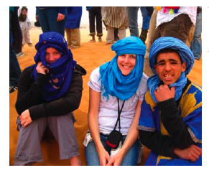
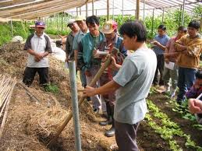
Study abroad
Internships
Undergraduate research
Experiential
co-curriculum
Experiential
co-curriculum
Collaborative Assignments
Formal undergraduate curriculum
First-year Seminars
Student Affairs
Advising
Community-based learning
Writing-intensive
Capstone courses
Experiential
co-curriculum
Where are the high-impact practices located?

Slide 23
What makes High Impact Practices high impact?
Experiential
co-curriculum
Invest time and effort (time on task)
Experiential
co-curriculum
Accountable talk and thinking
Formal undergraduate curriculum
Get (and give) frequent and meaningful feedback
Make daily decisions – judgment in uncertainty
Experiential
co-curriculum
Meet challenges to perspectives and belief, take risks, operate outside comfort zone
NEW ECOLOGY OF LEARNING
Opportunity to integrate, synthesize, make meaning

Slide 24
Being Disrupted and Disrupting Ourselves

Slide 25
The Recentered Curriculum

Slide 26
What makes High Impact Practices high impact?
Experiential
co-curriculum
Invest time and effort (time on task)
Experiential
co-curriculum
Accountable talk and thinking
Formal undergraduate curriculum
Get (and give) frequent and meaningful feedback
Make daily decisions – judgment in uncertainty
Experiential
co-curriculum
How do you make courses more like
high-impact practices?
How do you better integrate curriculum and co-curriculum?
Meet challenges to perspectives and belief, take risks, operate outside comfort zone
Opportunity to integrate, synthesize, make meaning

Slide 27
Engaging Difference
Ethical Judgment
Self-Reflection
Practitioner education, leadership
Massive
Online
Blended
interactive online
Formal undergraduate curriculum
High impact integrative
curriculum
Experiential
co-curriculum
Foundational Knowledge
Some generic and interchangeable
Some institutionally-distinctive expertise
Institutional Brand and Identity
Local and Identity
Jesuit and Catholic
Mentor-based
tradition
Residential, Diverse

Slide 28
Massive
Online & Digital environments
Engaging Difference
Ethical Judgment
Self-Reflection
Practitioner education, leadership
Blended
Formal undergraduate curriculum
High impact integrative
curriculum
Experiential
co-curriculum
HOW DO WE DESIGN FOR THIS CENTER?
Foundational Knowledge
Some generic and interchangeable
Some institutionally-distinctive expertise
Local and Identity
Jesuit and Catholic
Mentor-based
tradition
Residential, Diverse

Slide 29
Engaging Difference
Ethical Judgment
Self-Reflection
Practitioner education, leadership
Massive
Online
Blended
interactive online
Formal undergraduate curriculum
High impact integrative
curriculum
Experiential
co-curriculum
ePortfolio as integrative practice
Foundational Knowledge
Some generic and interchangeable
Some institutionally-distinctive expertise
Local and Identity
Jesuit and Catholic
Mentor-based
tradition
Residential, Diverse

Slide 30
ePortfolio: What Have We Learned?
Findings from the
Connect to Learning Project
C2L.mcnrc.org

Slide 31
Connect to Learning
FIPSE Funded national project, led by LaGuardia’s Making Connections National Resource Center
Partnership w/ AAEEBL, Trent & Judy Batson
Bret Eynon, Director
Judit Torok, Co-director
Laura Gambino, Research Director
Mikhail Valentin, Web Design
Randy Bass & Helen Chen
Senior Research Scholars

Slide 32
Notes:
24 campuses engaged in sustained networked inquiry
GO TO WEBSITE, IF FEASIBLE – IF NOT, USE NEXT SLIDE

Slide 35
What Difference does ePortfolio Make? C2L evidence supports 3 preliminary claims
Sophisticated ePortfolio initiatives:
Advance Student Learning & Success
Make Student Learning Visible
Catalyze Institutional Change

Slide 36
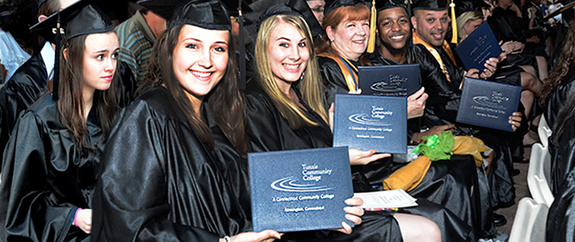
Claim # 1: ePortfolio initiatives Advance Student Learning & Success
At a growing number of campuses with sustained portfolio initiatives ePortfolio practices correlate with higher levels of student success, as measured by pass rates, GPA, retention, graduation, etc.

Slide 37
Claim # 1: ePortfolio initiatives advance student learning & success.
Helping students reflect on & connect their learning across academic, co-curricular and community-based learning experiences, sophisticated ePortfolio practices correlate with higher levels of student success, as measured by pass rates, GPA and retention.

Slide 38
ePortfolio was introduced into a required first semester “Mission” course in 2008-9, and student performance improved
 | Pre ePortfolio (2007-8) | Post ePortfolio 2009-12
GPA in Mission Course | B (3.213) | B+ (3.508)
GPA in all first semester courses | B- (2.933) | B (3.095)

Slide 39
ePortfolio integrated into Metro Health Academies, an SFSU learning community project for high-risk students
 | Metro Academy, First Year/First Time Students | All SFSU First Year/ First Time Students
1 Yr Retention Rate | 90.0% | 79.3%
3 Yr Retention Rate | 79.0% | 60.0%
4 Yr Grad’n Rate | 24.6% | 14.9%

Slide 40
Queensborough Community College

Slide 41
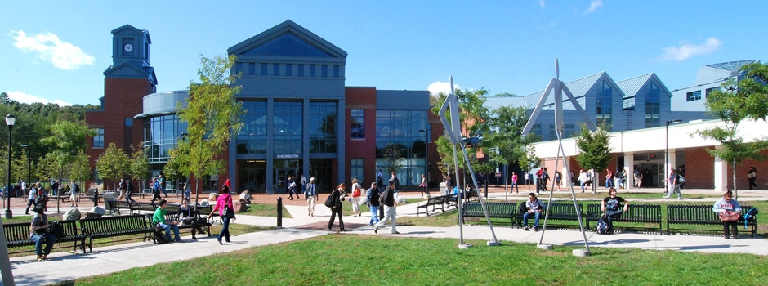
Tunxis Community College

Slide 42
How does ePortfolio Shape the Student Learning Experience?
C2L Core Survey
Conducted on multiple C2L campuses across three semesters: Fall 2011, Spring 2012, Fall 2012 (Spring 2013 pending) n=6,729
Goal: to build a common data set that can help us better understand the contours of the ePortfolio-enhanced student learning experience

Slide 43
Building my ePortfolio | Agree/ Strongly Agree
Helped me make connections between ideas | 75.6%
Helped me think more deeply about course content | 64.4%
Allowed me to be more aware of my growth & development as a learner | 69.3%
My (ePortfolio-enhanced) course engaged me in… | Quite a Bit/ Very Much
Synthesizing & organizing ideas, information or experiences in new ways | 83.1%
Applying theories or concepts to practical problems or in new situations | 77.2%
My course contributed to my knowledge, skills and personal development in understanding myself | 78.6%

Slide 44
What makes High Impact Practices high impact?
Experiential
co-curriculum
Invest time and effort (time on task)
Experiential
co-curriculum
Accountable talk and thinking
Formal undergraduate curriculum
Get (and give) frequent and meaningful feedback
Make daily decisions – judgment in uncertainty
Experiential
co-curriculum
Meet challenges to perspectives and belief, take risks, operate outside comfort zone
NEW ECOLOGY FOR LEARNING
Opportunity to integrate, synthesize, make meaning

Slide 45
Claim #2: ePortfolio Initiatives Make Student Learning Visible
ePortfolio initiatives support reflection, social pedagogy, and deep learning.
Helping students reflect on and connect their learning across academic and co-curricular learning experiences, sophisticated ePortfolio practices transform the student learning experience. Advancing higher order thinking and integrative learning, the connective ePortfolio helps students construct purposeful identities as learners.

Slide 46
Claim #2: ePortfolio Initiatives Make Student Learning Visible
ePortfolio initiatives make learning more visible for students themselves, helping them chart their growth and value their learning.
For faculty and staff, ePortfolios can focus inquiry and reflection on student learning, deepening professional development and outcomes assessment processes.
Supporting the construction of a learning whole greater than the sum of its parts, ePortfolio initiatives can help institutions understand and make a case for the distinctive contribution to student development.

Slide 47
“Through my ePortfolio I learned how to express myself as a hard working student. Being a shy girl was always an issue for me. This ePortfolio helped me to see a new me… the potential I have as a student and what I want to accomplish in my life.” Rezwana Islam
Reflective & integrative pedagogies focus students on their learning, helping them make deeper and broader connections and come to build new, more purposeful identities as learners.
Building my ePortfolio | Agree/ Strongly Agree
Allowed me to be more aware of my growth & development as a learner | 69.3%
Helped me make connections between ideas | 75.6%

Slide 48
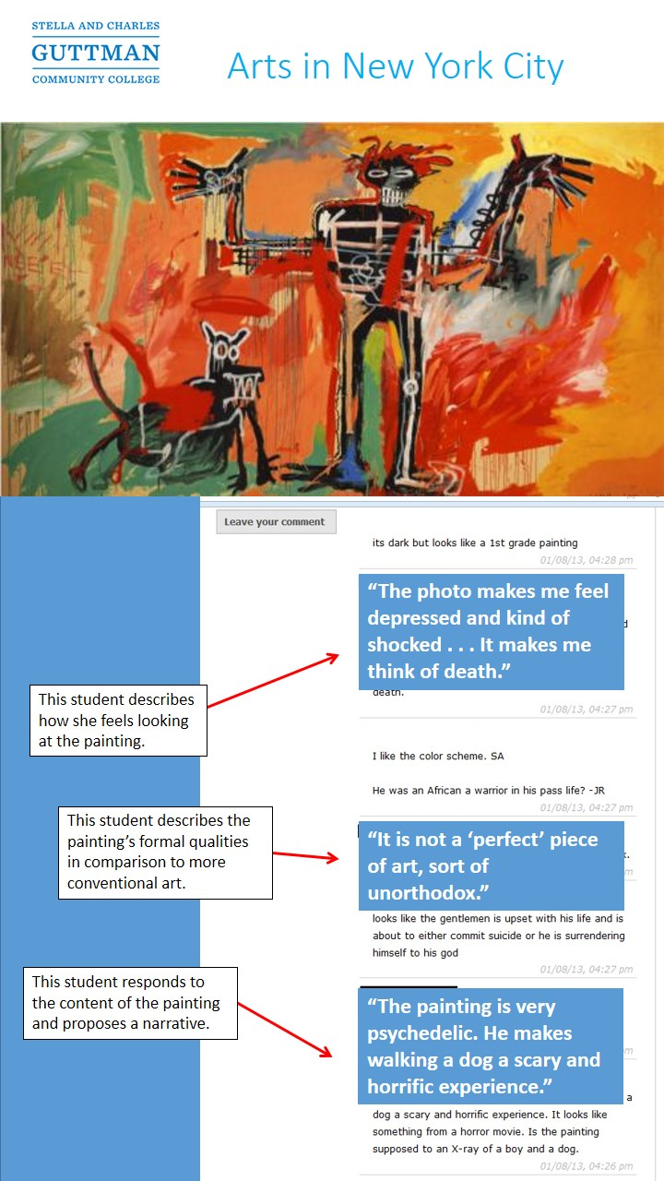
Making Learning Visible to Others
ePortfolio as a Social Pedagogy
Feedback, Peer Critiques
External Audiences – Family, Professionals, Experts in the field
Collaborating on Shared Projects
Constructing Sustained Knowledge Communities

Slide 49
Social Pedagogies Framework (Bass and Elmendorf, 2010)

Slide 51
In this same spirit, Dr. Andrew Wier’s microbiology course requires students to interact with one another as they build a robust ePortfolio page. The students spend eight weeks developing an ePortfolio dedicated to a specific species of bacterial phylum.
The social pedagogy factor of the assignment is highlighted when students review one another’s work. This component is key! Students are required to share their page with all logged-in users. To reinforce the sharing aspect, 15% of final exam material is taken from student ePortfolios.
Pace University Campus Portfolio, Catalyst Site: http://pu.mcnrc.org/soc-practice/

Slide 52
ePortfolio and social pedagogies in High-impact Practices
U Delaware Campus Portfolio, Catalyst Site:
http://ud.mcnrc.org/ref-practice/

Slide 53
ePortfolio and social pedagogies in High-impact Practices
IUPUI Campus Portfolio, Catalyst Site: c2l.mcnrc.org/iupui-soc-practice/

Slide 54
Building my ePortfolio helped me to make connections between ideas…

Slide 55
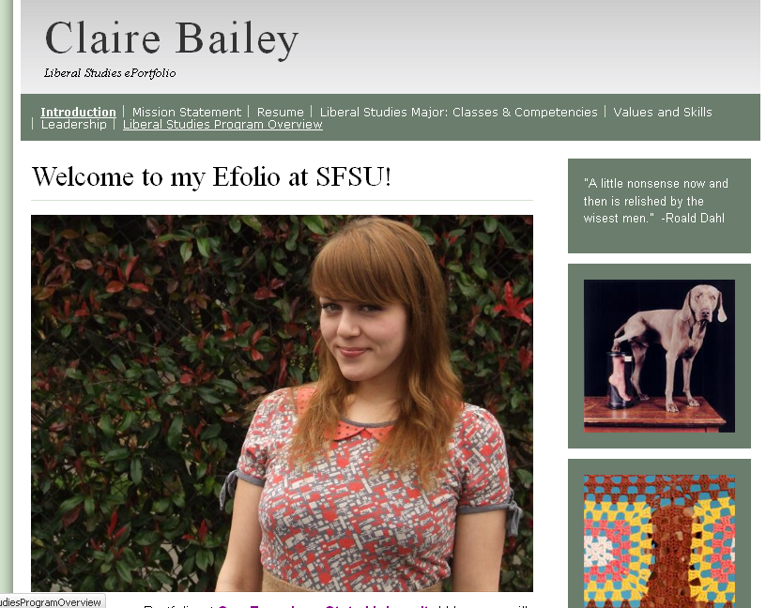
Sophisticated ePortfolio practice makes the integrative qualities of student learning visible to faculty and the institution. Grounding outcomes assessment in these artifacts helps faculty see classrooms, students, and their own work in new contexts, empowering them to “close the loop” in unique and powerful ways.
Authentic Artifacts of
Integrative Learning
Re-Design Program
Curricula & Pedagogy
Purposeful
Faculty Engagement
Learning-Focused
Institutional Outcomes
Assessment

Slide 56
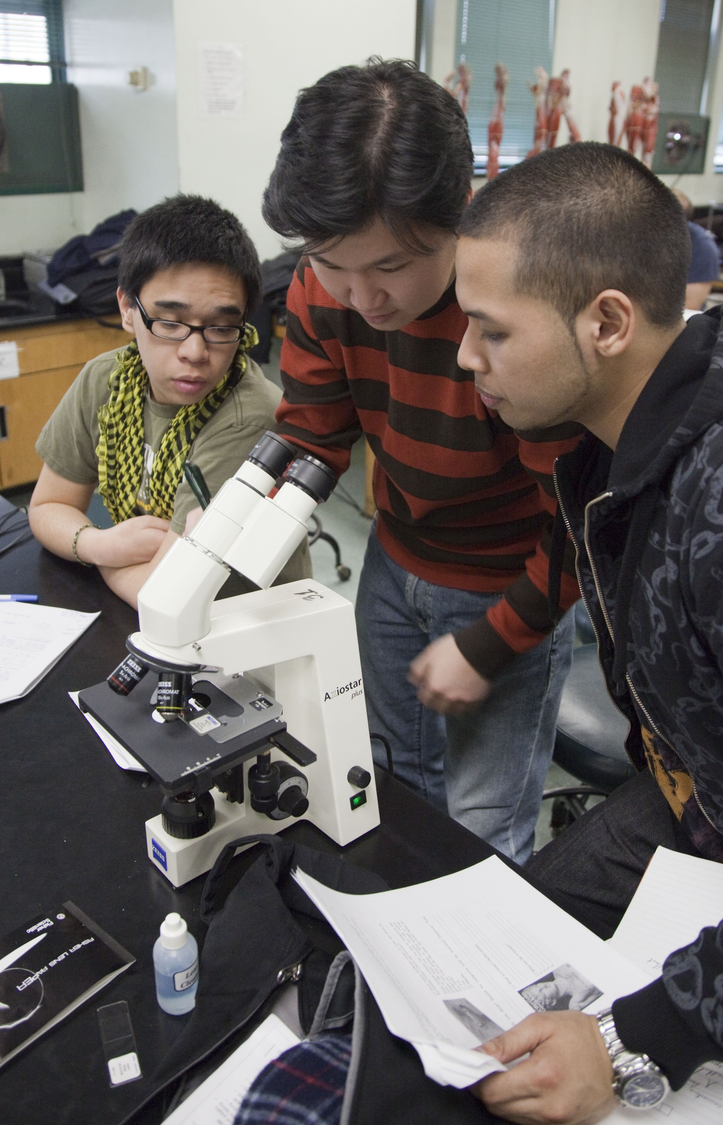
Claim #3: ePortfolio initiatives Catalyze learning-centered Institutional Change
Focusing attention on student learning and prompting purposeful connection across departments and divisions, ePortfolio initiatives can catalyze campus cultural and structural change, helping the institution move towards becoming an adaptive learning organization.

Slide 57
Engaging Difference
Ethical Judgment
Self-Reflection
Practitioner education, leadership
Massive
Online
Blended
interactive online
Formal undergraduate curriculum
High impact integrative
curriculum
Experiential
co-curriculum
ePortfolio as integrative practice
Foundational Knowledge
Some generic and interchangeable
Some institutionally-distinctive expertise
Local and Identity
Jesuit and Catholic
Mentor-based
tradition
Residential, Diverse

Slide 58
Northeastern University
“[based on our read of the portfolios… the redesign transformed the program from a collection of courses into an intentionally designed learning experience… from a ‘degree with a portfolio requirement’ into a portfolio program whose students graduate with a collection of signature work that evidences their capabilities.”
“Are we who we think we are? ePortfolios as a Tool for Curriculum Redesign.” Gail Matthews-DeNatale

Slide 59
Liberal Education and the future recentered Curriculum
Self-authorship
Students learn on an arc that moves them inward and outward
Formal learning
Informal learning
Contribution to a knowledge community
Reflection and sense-making
High impact integrative
curriculum
Unstructured complex problems
Authentic work
Interdisciplinary Inquiry
Social learning
Opportunities for integrating theory and practice, connecting disparate learning experiences
Foundational Knowledge
Some generic and interchangeable
Some institutionally-distinctive expertise
Local and Identity-specific
Urban setting
Community-based
Mentor-based
Residential, Diverse
DESIGN CHALLENGE: How do we design for this center?
Notes:
Collapse into one or just narrate the analytics piece in the text.

Slide 60
How do we create an integrated learning experience for students across an increasingly disintegrated set of structures and contexts?
How do we define education, and assess learning broadly, in a context that is increasingly narrowing on granular certification and instrumental metrics?
How do we articulate a sense of institutional distinctiveness – one that incorporates the contributions of faculty and the campus learning community—in an era of where large portions of the curriculum may become commodified, generic and interchangeable?

Slide 61
Jack DeGioia, President, Georgetown
Three interlocking and inseparable elements of the University:
Formation of men and women
Knowledge-creation through scholarship and research
Public Good and the Common Good
Notes:
The concept of formation in the Jesuit tradition is at the heart of an education dedicated to shaping students to be fully human and to cultivate a sense of personal responsibility for improving the world. Formation is not just about those ancillary aspects of education that layer onto academic or cognitive development. Formation is fundamentally about the goal of integration, of striving to cultivate a balanced person, with intellectual, affective, creative and reflective capacities.
Formation is also fundamentally a learner-centered concept; it is not only about transmission of knowledge but also what the student or learner makes of all the shaping influences that are provided as part of the environment. This is how, for example, formation is used in the context of professional or practitioner education, as the fullest sense of professional identity. In both the Jesuit tradition and practitioner education, formation is ultimately about how one embodies knowledge, traditions, and values—and expresses them through practice.
See The Formation of Scholars: Rethinking Doctoral Education in the 21st Century (Jossey-Bass, 2008) and related Carnegie studies of the professions.

Slide 62
Formation
Integration
Transformation

Slide 63
Learning to learn:
Empowered as independent learners, with curiosity and intellectual agility.
Well-being:
Capacity for flourishing, connectedness, self-awareness and self-efficacy.
Integration: Develop interior freedom and an integrated sense of
purpose and
identity
Resilience: Ability to adapt to change, take responsible risks
and deal with complexity
Empathy:
Openness and ethical stance to others, with a
global horizon
Magis Measures: Formational Wider Outcomes (interdependent with skills, knowledge, abilities)

Slide 64
Magis Measures:
Formational Wider Outcomes (interdependent with skills, knowledge, abilities)
Learning to learn:
Empowered as independent learners, with curiosity and intellectual agility.
Integration: Develop interior freedom and an integrated sense of
purpose and
identity
Well-being:
Capacity for flourishing, connectedness, self-awareness and self-efficacy.
Cross-cutting Traits
Curiosity
Creativity
Risk-taking
Humility
Collaboration
Cross-cultural competence
Integrity
Self-efficacy
Moral discernment
Ethical judgment
Imagination
Reflectiveness
Empathy:
Openness and ethical stance to others, with a
global horizon
Resilience: Ability to adapt to change, take responsible risks
and deal with complexity

Slide 65
Designing a more integrated university:
formation, inquiry, and the common good
What’s it take?
Connect
Integrate theory and practice
Connect curriculum to co-curriculum
Move high-impact experiential learning into the business model
Share responsibility for wider outcomes
Make interdisciplinarity structural
Unbundle
Decompose courses into smaller units and create more flexible curricular structures
Liberate credits from seat time
Shift from courses to competencies as measures of progress
Shape
Create purposeful ways for students to shape and make sense of their education
Measure and assess the hard-to-measure outcomes
Provide better roadmaps for students (holistic analytics, alumni pathways)
Create a more authentic learning record

Slide 66
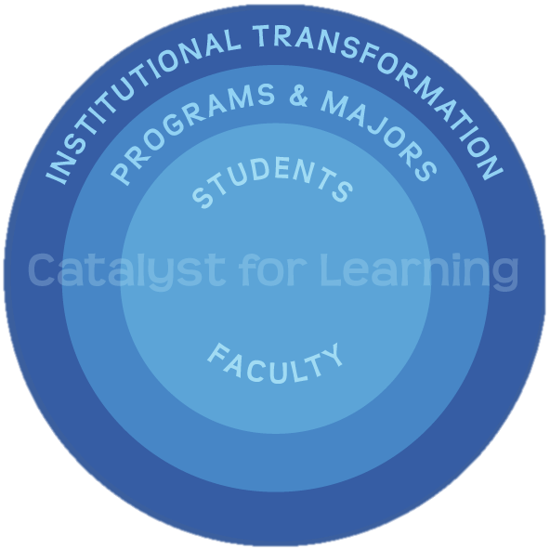
What do successful campuses do to
launch, build and sustain effective ePortfolio initiatives?
What Does it Take to Make a Difference?

Slide 67
What Does it Take to Make a Difference? Five Interlocking Sectors

Slide 68
What Does it Take to Make a Difference? Inquiry – Reflection – Integration

Slide 70
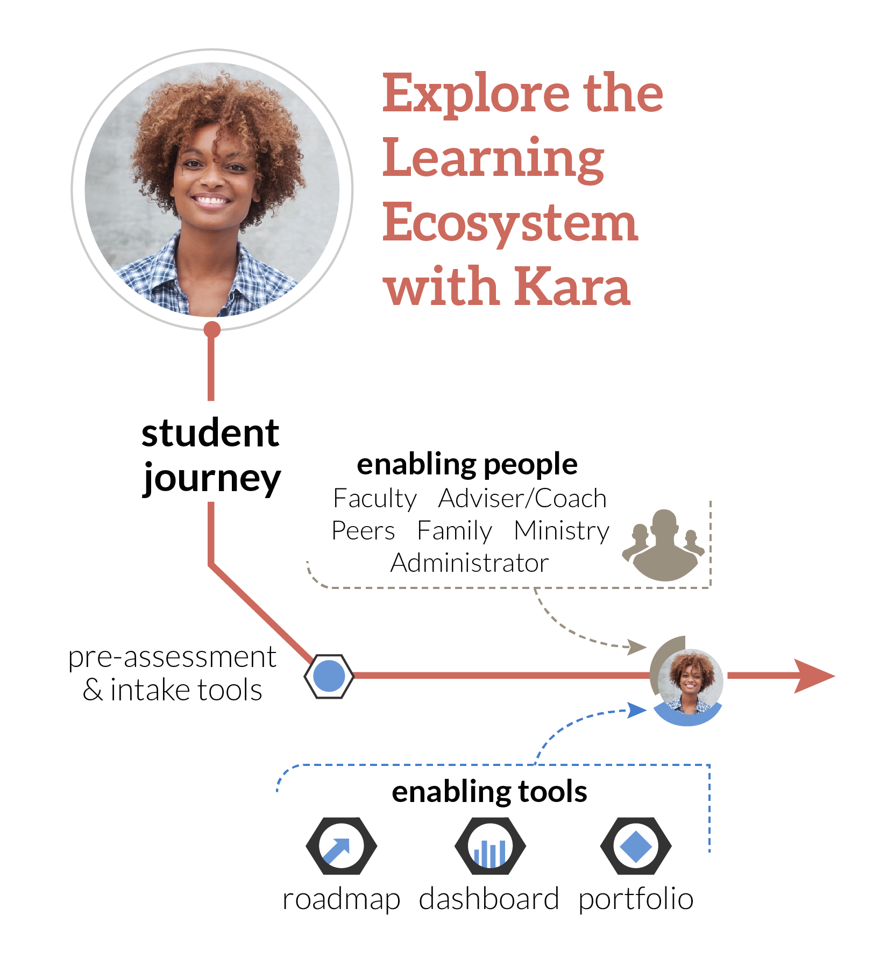

Slide 71
The Magis Measures
Learning to Learn
Well-being and Flourishing
Resilience
Empathy
Integration
ad

Slide 72
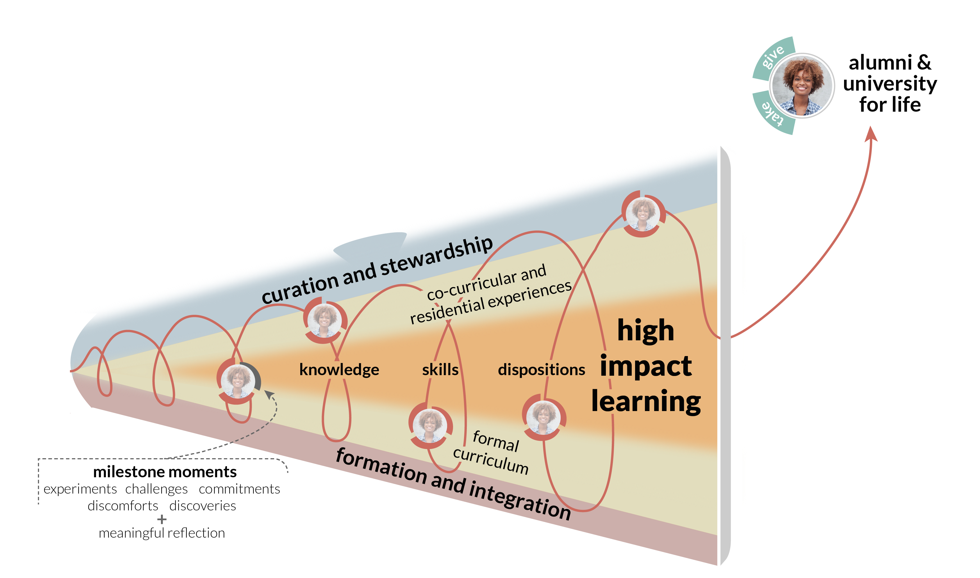
How do you create more high-impact learning experiences by design?

Slide 73
How do we further strengthen and institutionalize our role in curating high-impact experiences outside the classroom?

Slide 74
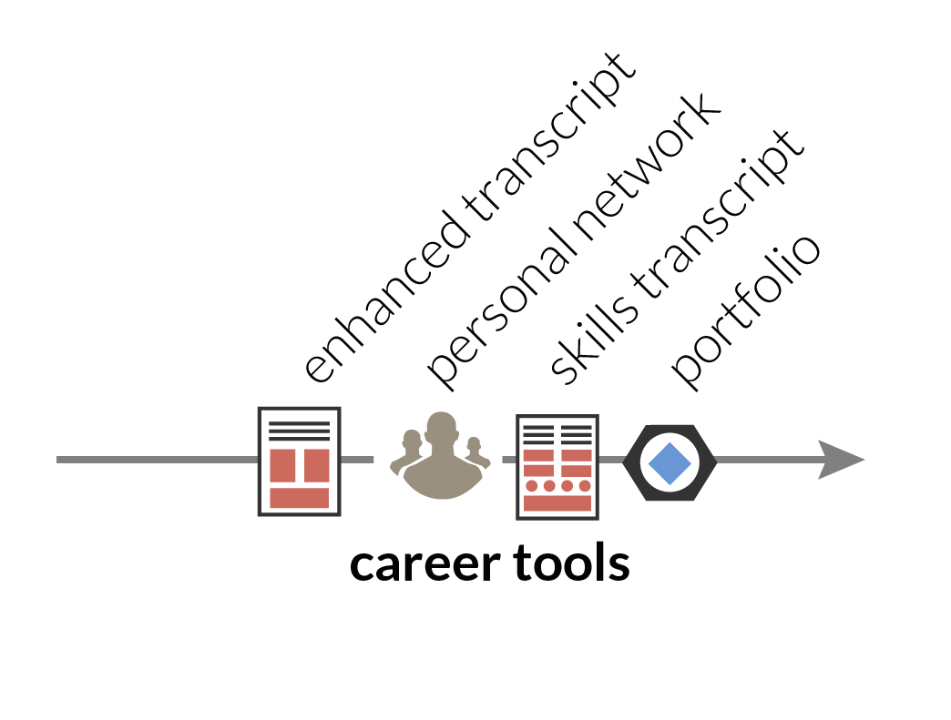
What should an authentic learning record look like?

Slide 75
INTEGRATIVE
LEARNING
ANALYTICS

Slide 76
INTEGRATIVE
LEARNING
ANALYTICS

Slide 77
INTEGRATIVE
LEARNING
ANALYTICS

Slide 78
Learning Analytics “attainment” “activity”
Authentic student work
Artifacts of inquiry and practice
Learning Analytics
“dispositional”
Formal undergraduate curriculum
High impact integrative
curriculum
Experiential
co-curriculum
Foundational Knowledge
Some generic and interchangeable
Some institutionally-distinctive expertise
ePortfolios as capture of the whole education and institutional value
Integrative of all analytics?
Local and Identity-specific
Urban setting
Community-based
Mentor-based
Residential, Diverse

Slide 79
Toward a system of
Learning analytics
Empowerment
(Students)
Hermeneutic
(faculty, designers)
Empirical
(institution)
Adapted from Simon Buckingham Shum
(University of Technology Sydney; Learning Emergence.net)

Slide 80
Designing a more integrated university:
formation, inquiry, and the common good
What’s it take?
Connect
Integrate theory and practice
Connect curriculum to co-curriculum
Move high-impact experiential learning into the business model
Share responsibility for wider outcomes
Make interdisciplinarity structural
Unbundle
Decompose courses into smaller units and create more flexible curricular structures
Liberate credits from seat time
Shift from courses to competencies as measures of progress
Shape
Create purposeful ways for students to shape and make sense of their education
Measure and assess the hard-to-measure outcomes
Provide better roadmaps for students (holistic analytics, alumni pathways)
Create a more authentic learning record

Slide 81
Questions, Comments, Feedback Randy Bass Georgetown University bassr@georgetown.edu
PLEASE DO NOT REPRODUCE WITHOUNT PERMISSION

