Slide 1
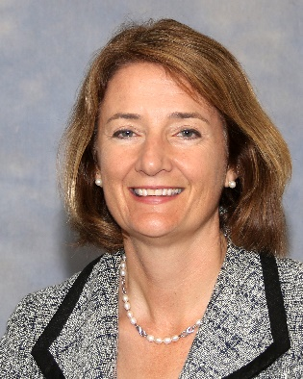
Department Of Surgery Grand Rounds
7th Annual Women in Surgery Visiting Professor
September 18th, 2024- 7:00AM-8:00AM
CTRE Auditorium
Mary T. Hawn, M.D., MPH
Emile Holman Professor and Chair, Department of Surgery
Stanford University School of Medicine
Leadership Lessons from Challenging Times
Dr. Mary T. Hawn is the Emile Holman Professor of Surgery and Chair of the Department of Surgery at Stanford University. Dr. Hawn, a native of Michigan, received her education and general surgical training at the University of Michigan. She completed her minimally invasive surgical fellowship at Oregon Health and Sciences University.
Her clinical area of specialty is minimally invasive foregut surgery. In addition, she has earned a Masters in Public Health from the University of Michigan and her Certificate in Healthcare Quality and Safety from the University of Alabama at Birmingham. Dr. Hawn has extensive research in surgical quality measurement and national policy affecting surgical populations. Her work has changed guidelines for non-cardiac surgery in patients with coronary stents and also informed policy about national surgical quality measurement.
Dr. Hawn is the current Chair of the American Board of Surgery, and current President of the Society of Surgical Chairs. She also serves on the editorial board of the Annals of Surgery and as an Associate Editor of the Journal of the American College of Surgeons. Dr. Hawn has several additional national leadership roles including Treasurer for James IV Society, Trustee at Large for the Society for Surgery of the Alimentary Tract, past President of the Halsted Society, immediate past Secretary of the American Surgical Association, and immediate past President of the Association of VA Surgeons. In recognition of her scientific leadership and contributions, she was elected to the National Academy of Medicine in 2021. She is the co-Editor of the surgical textbooks Operative Techniques in Surgery and Mulholland and Greenfield Surgery: Scientific Principles and Practice.

