Slide 1
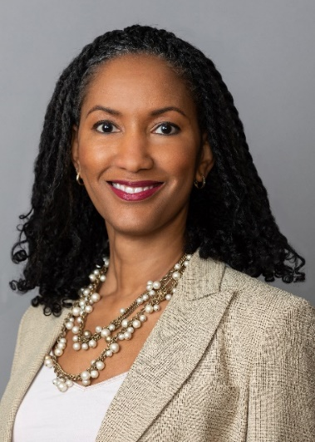
Department Of Surgery Grand Rounds
6th Annual Women in Surgery Visiting Professor
September 30th,2023- 7:00AM-8:00AM- CTRE Auditorium
Patricia L. Turner MD, MBA ,FACS
Executive Director and Chief Executive Officer
American College of Surgeons
Unconventional Insights into
Surgical Leadership
Dr. Patricia L. Turner is the Executive Director and CEO of the American College of Surgeons and a Clinical Professor at the University of Chicago Medicine. Dr. Turner’s roles in national professional organizations or institutions are numerous and include serving as a member of the Boards of Directors of the Council of Medical Specialty Societies, Corporate Member CEO of The Joint Commission, Specialty Society CEO Coalition member, and Chair of the Society of Black Academic Surgeons Foundation Fund. She is a past President of the Society of Black Academic Surgeons and past member of the Wake Forest Baptist Medical Center Board of Directors. Dr. Turner is a graduate of the University of Pennsylvania and the Bowman Gray School of Medicine at Wake Forest University. She completed a residency in surgery at Howard University Hospital in Washington, DC and fellowship training in minimally invasive and laparoscopic surgery at the Mount Sinai School of Medicine, Weill-Cornell University School of Medicine, and Columbia University School of Medicine in New York City. Dr. Turner received an MBA degree at the University of Maryland Robert H. Smith School of Business. She is board certified in Surgery, is a Fellow of the American College of Surgeons, and member of the American Surgical Association, AMA, National Medical Association, Southern Surgical Association, Southeastern Surgical Congress, SUS, Society of Black Academic Surgeons, AWS, Latino Surgical Society.

