Slide 1
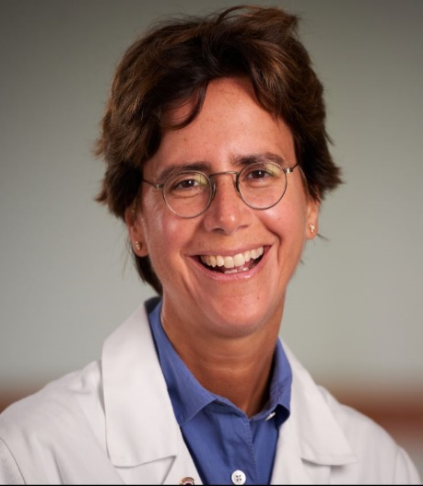
2023 Annual Women in Surgery Visiting Lecturer
Sponsored by the Loyola Women in Surgery Group
Department of Surgery Grand Rounds
Wednesday February 8 ● 8:00-9:00 am ● SSOM 390
Julie Ann Sosa, MD, MA, FACS, FSSO, MAMSE
Leon Goldman MD Distinguished Professor of Surgery
Chair, Department of Surgery
University of California San Francisco
Advancing Change with Evidence, Courage, and Compassion
Dr. Julie Ann Sosa is the Leon Goldman MD Distinguished Professor of Surgery and Chair of the Department of Surgery at the University of California San Francisco, where she is also a Professor in the Department of Medicine and affiliated faculty for the Philip R. Lee Institute for Health Policy Studies. Her clinical interest is in endocrine surgery, with a focus in thyroid cancer. She is an NIH- and FDA-funded investigator and author of more than 340 peer-reviewed publications and 80 book chapters and reviews, all largely focused on outcomes research, health care delivery, hyperparathyroidism, and thyroid cancer, with a focus on clinical trials. She has authored or edited 7 books. Dr Sosa is Treasurer of the American Thyroid Association (ATA) and serves on the Board of Directors/Executive Council of the ATA and International Thyroid Oncology Group, as well as practice guidelines committees for the ATA, NCCN, and the American Association of Endocrine Surgeons; for the ATA, she is chair of the committee responsible for writing the next iteration of differentiated thyroid cancer guidelines. She is the Editor-in-Chief of the World Journal of Surgery and is an editor of Greenfield’s Surgery: Scientific Principles and Practice. She has mentored more than 90 students, residents, and fellows, for which she was recognized with induction as a full member to the American College of Surgeons Academy of Master Educators in 2020, and with the Lewis E. Braverman Distinguished Lectureship Award from the ATA in 2017. Dr Sosa was born in Montreal and raised in upstate New York. She received her AB at Princeton, MA at Oxford, and MD at Johns Hopkins, where she completed the Halsted residency and a fellowship.

